Slide 1
IPL AUCTION
By:
Antony Jerome D

Slide 2

Table Creation for IPL Ball

Slide 3
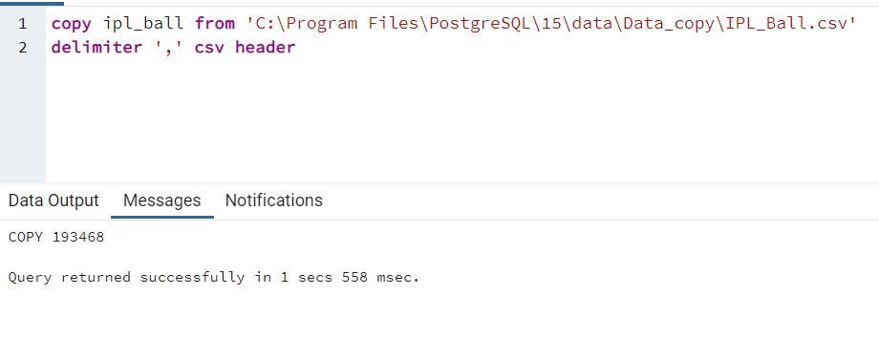
Loading data for IPL Ball

Slide 4

Table creation for IPL Matches

Slide 5

Loading data for IPL Matches

Slide 6
Project Queries

Slide 7
Bidding on Batters

Slide 8
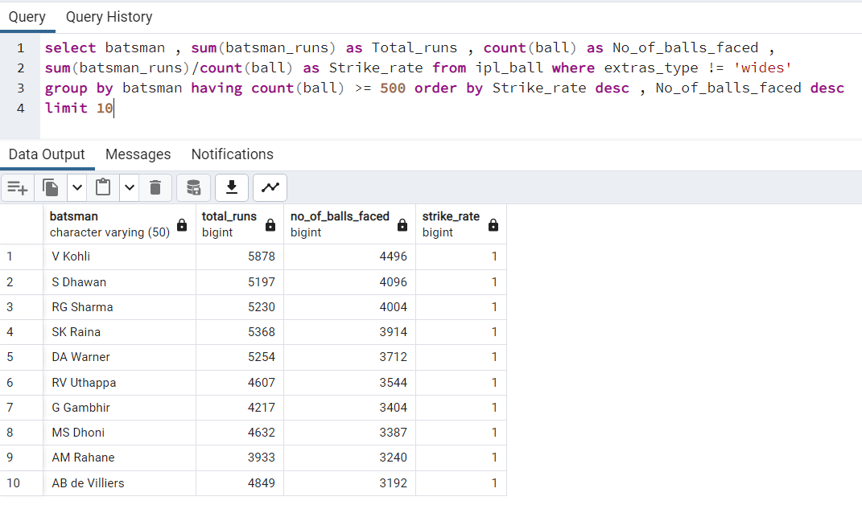
Aggressive Batsman

Slide 9

Aggressive batsman – graph

Slide 10
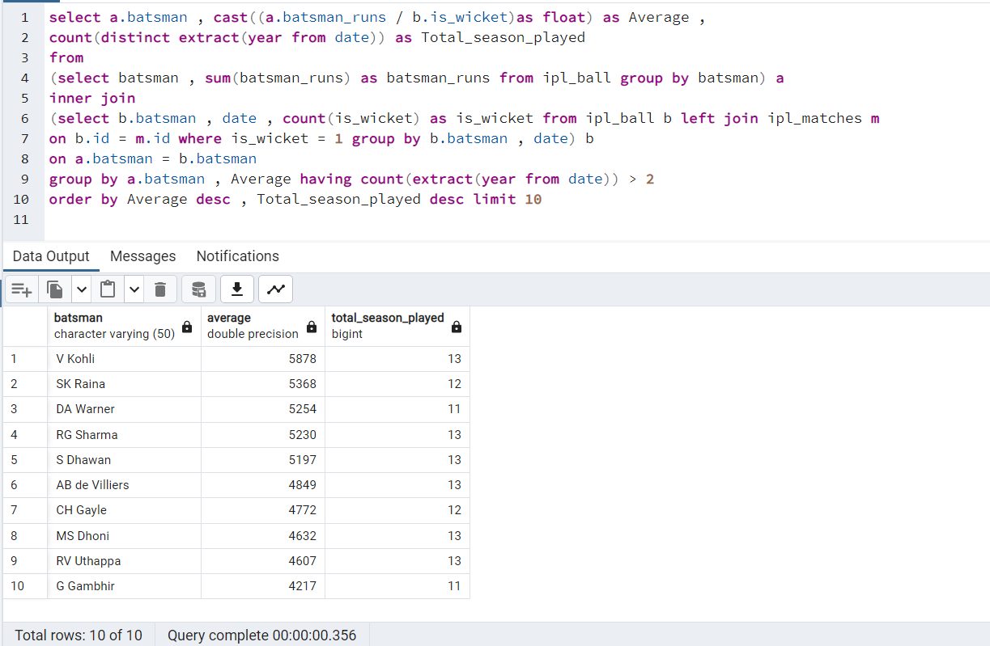
Anchor Batsman

Slide 11

Anchor Batsman - graph

Slide 12
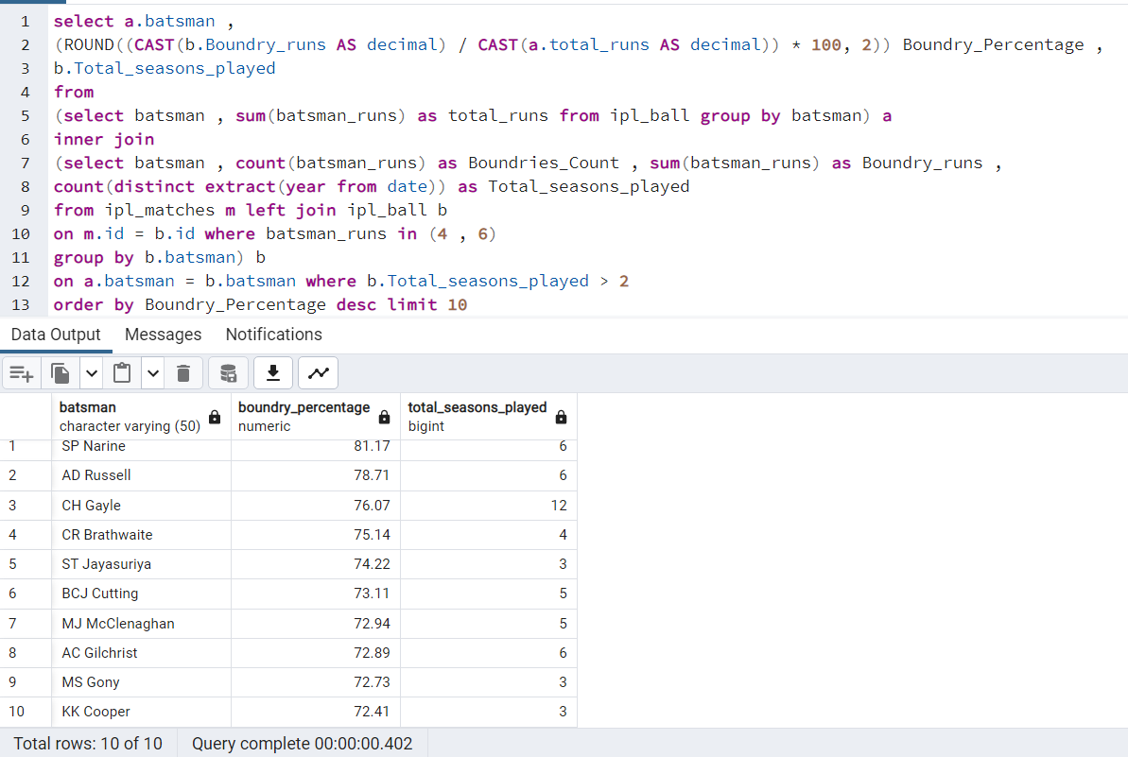
Hard Hitter Batsman

Slide 13

Hard Hitter Batsman - graph

Slide 14
Bidding on Bowlers

Slide 15
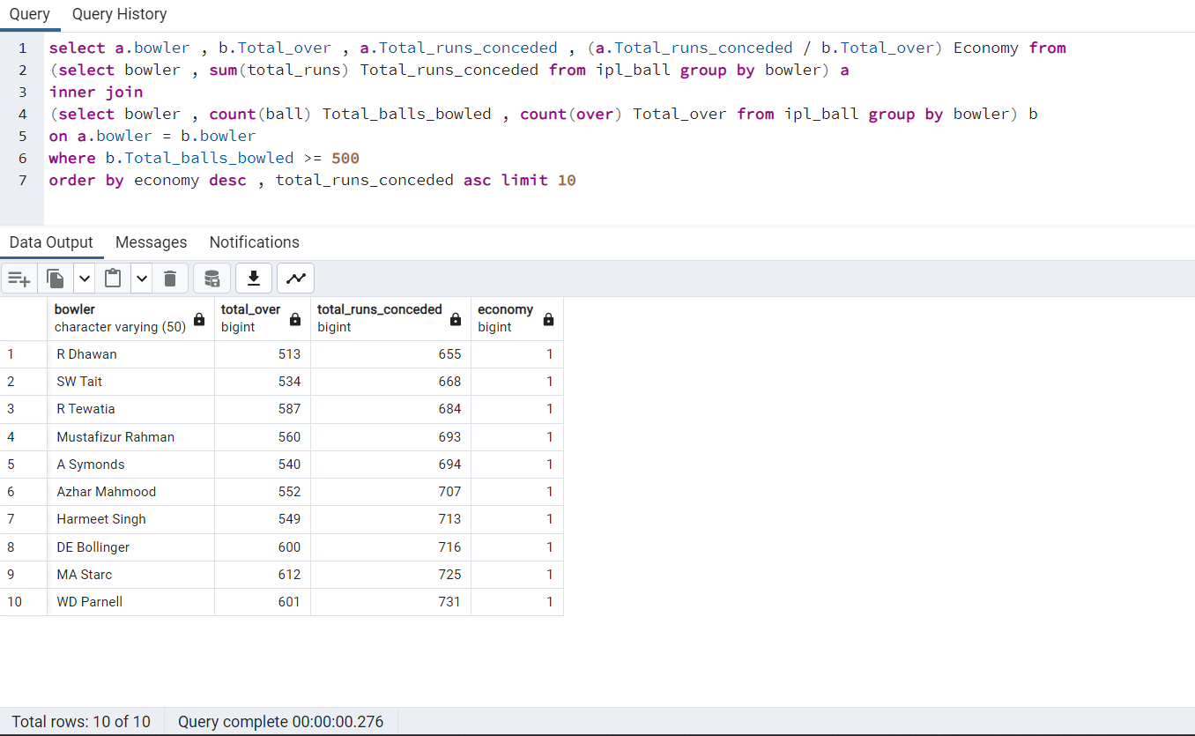
Economical Bowlers

Slide 16

Economical Bowlers - graph

Slide 17
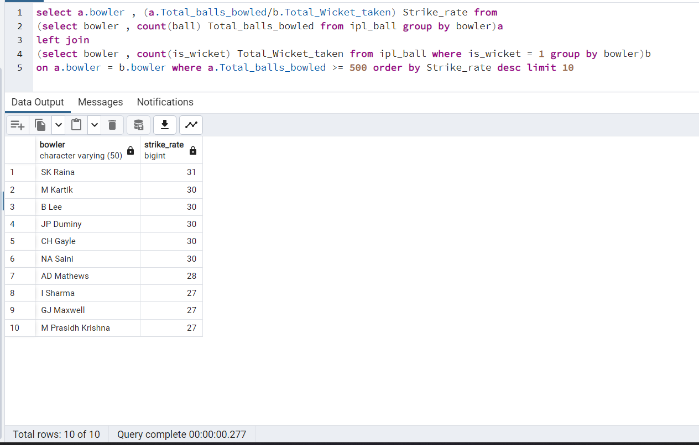
Wicket – Taking Bowlers

Slide 18

Wicket Taking bowlers - graph

Slide 19

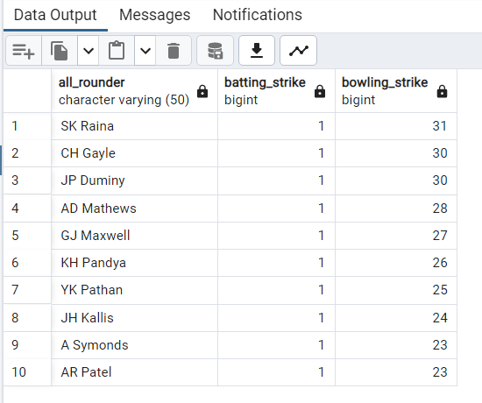
All rounders

Slide 20

All rounder - graph

Slide 21
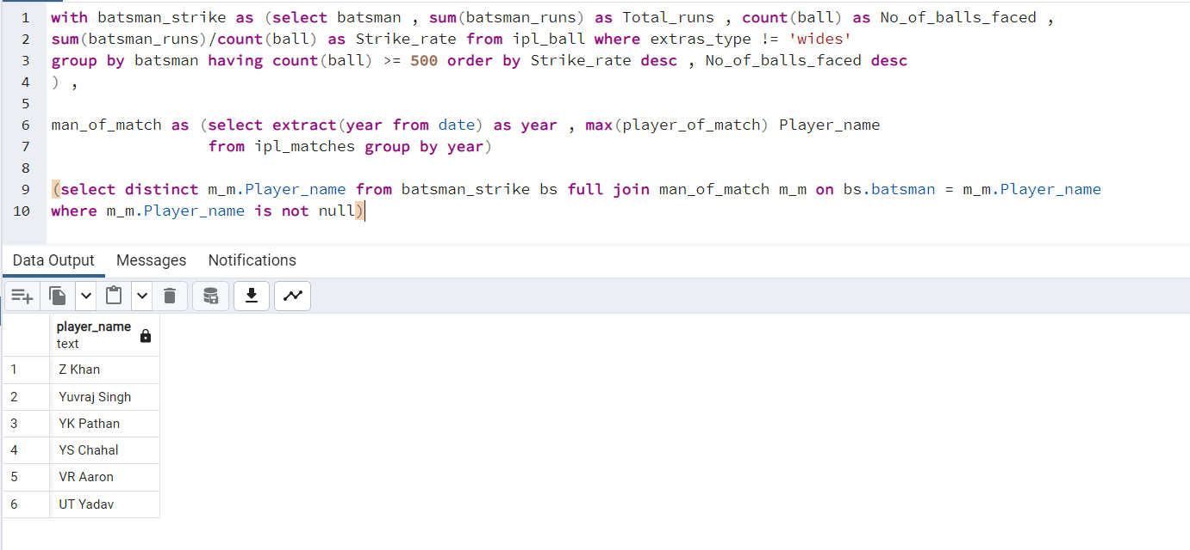
Wicket keeper

Slide 22
Additional Questions

Slide 23




Slide 24



Slide 25
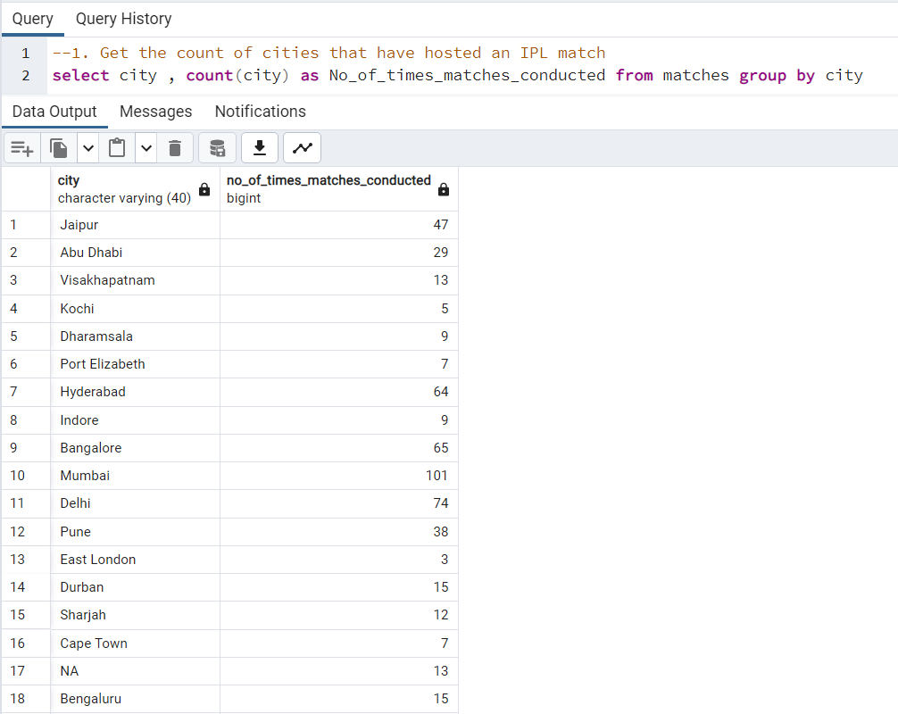
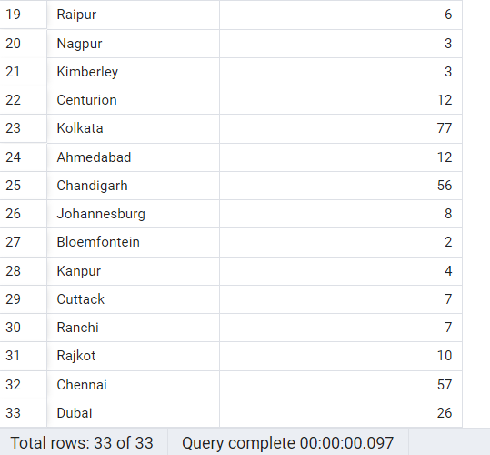

Slide 26

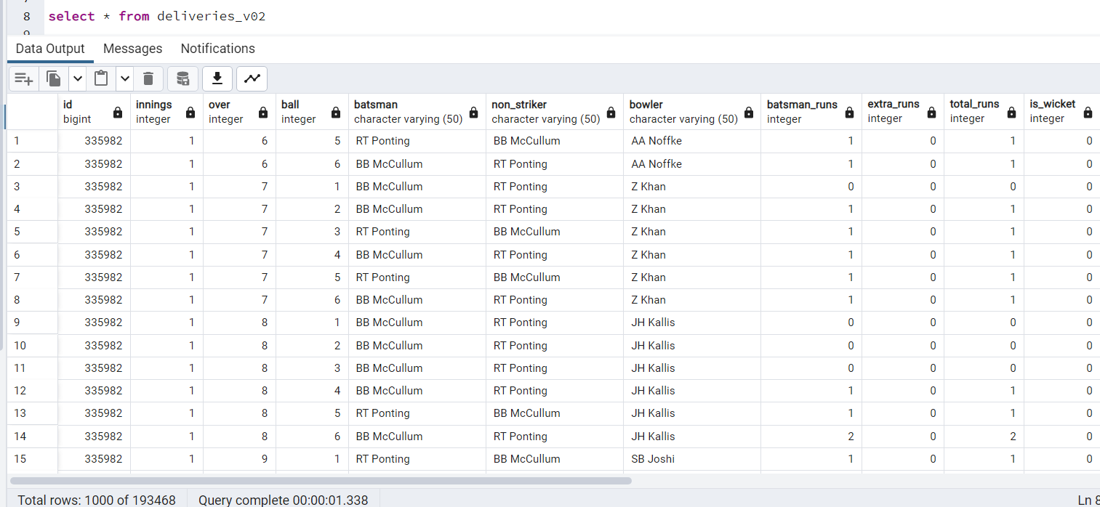

Slide 27
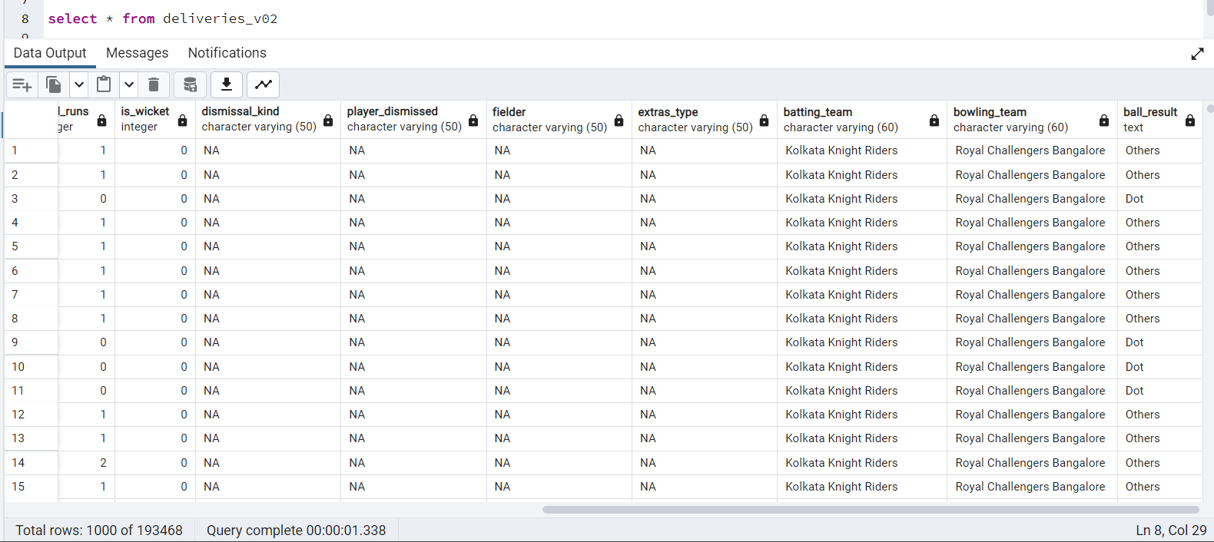

Slide 28


Slide 29
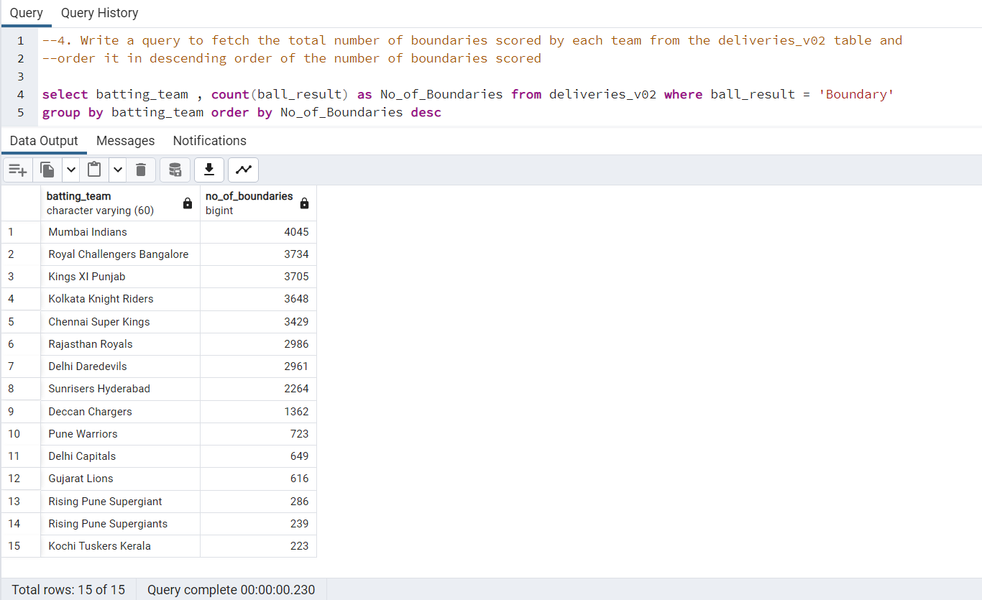

Slide 30
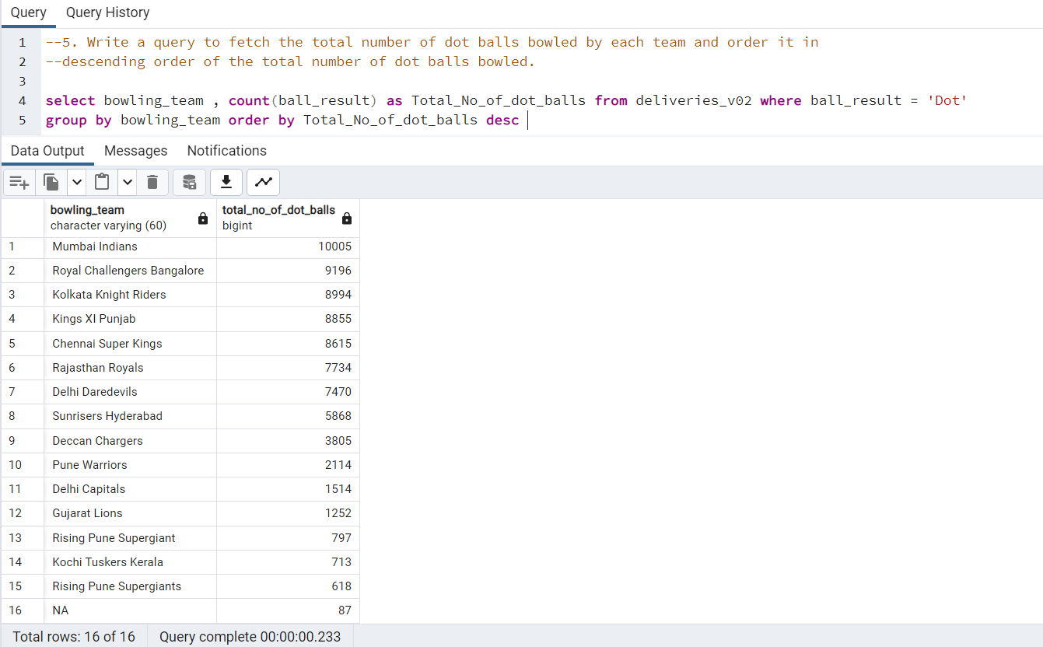

Slide 31
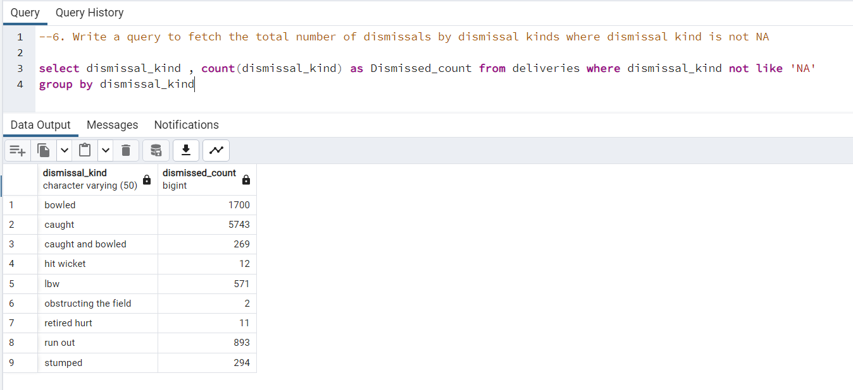

Slide 32
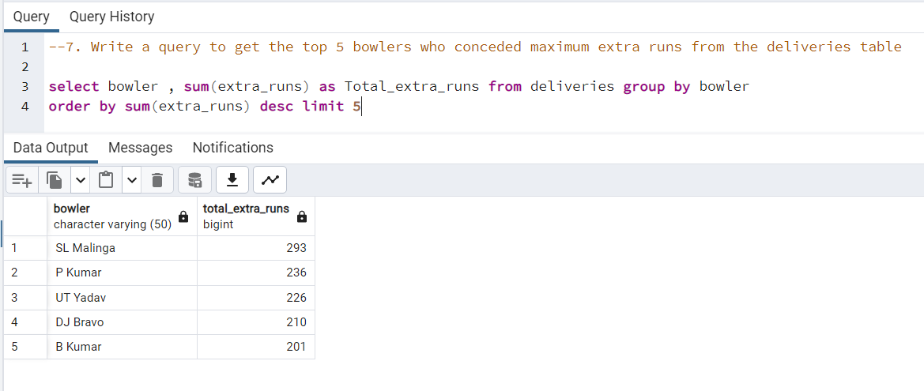

Slide 33
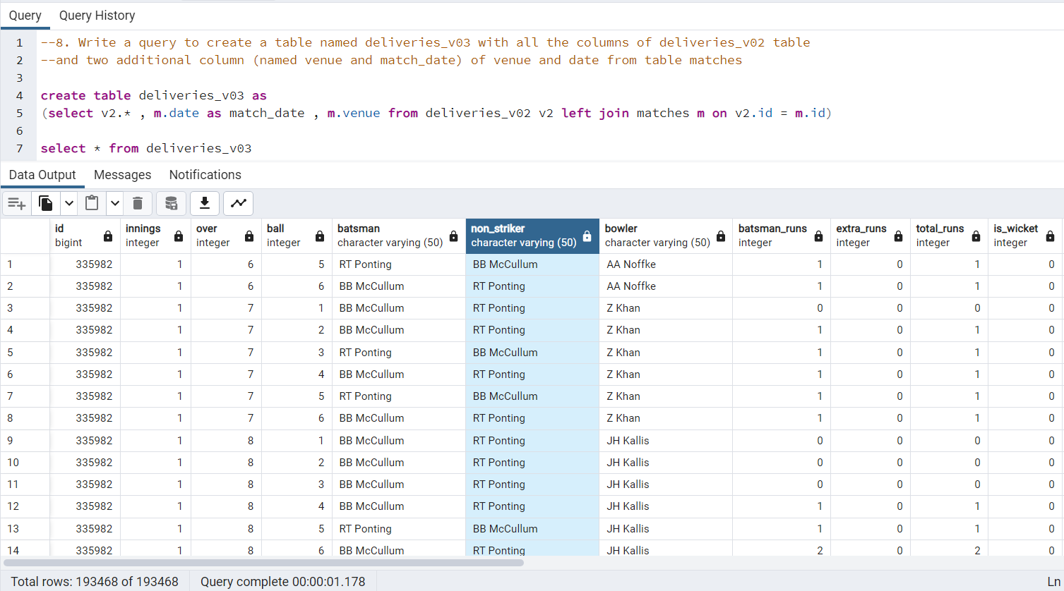

Slide 34
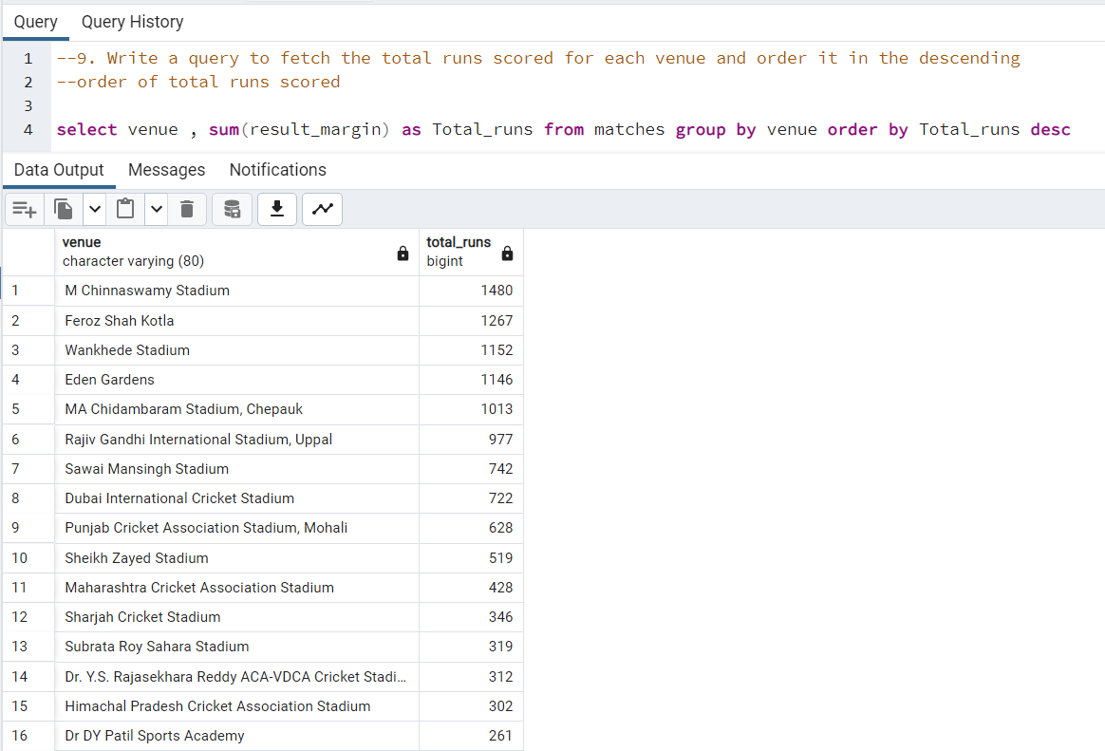
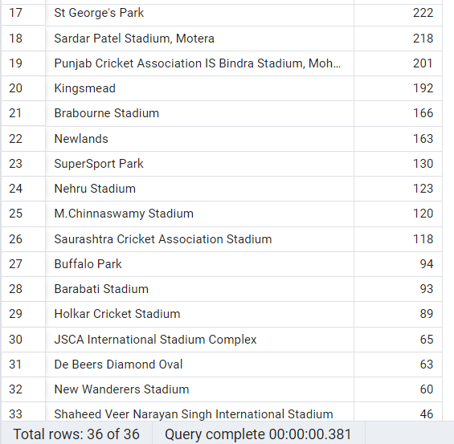


Slide 35
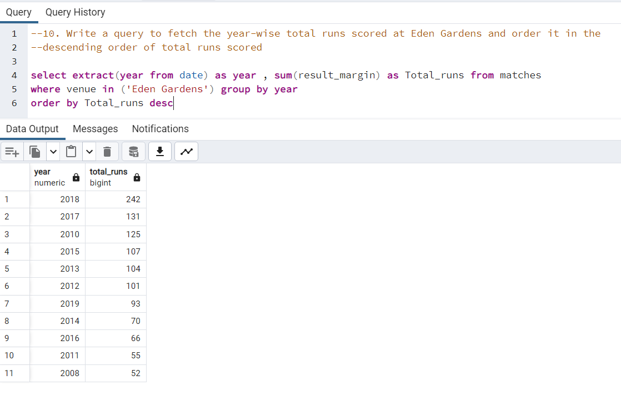

Slide 36
Thank You

